Slide 1
The Buddies Status Report 2/18/2015
Djordje Ljubinkovic
Alex Moser
Chris Reaper
Baylee Smith

Slide 2
What We Have Accomplished
Met with Dr. Geise on 3 occasions
Clarified schedule to be a drag and drop interface
Updated user stories
Completed first draft of prototypes and use cases
Strategized to use VB for the UI and SQL for the database
Excel macros may be used to manipulate the reports

Slide 3
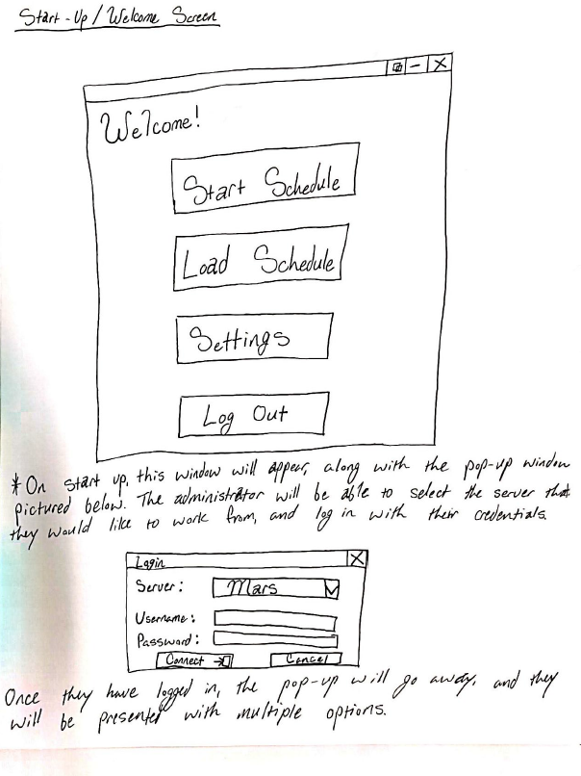
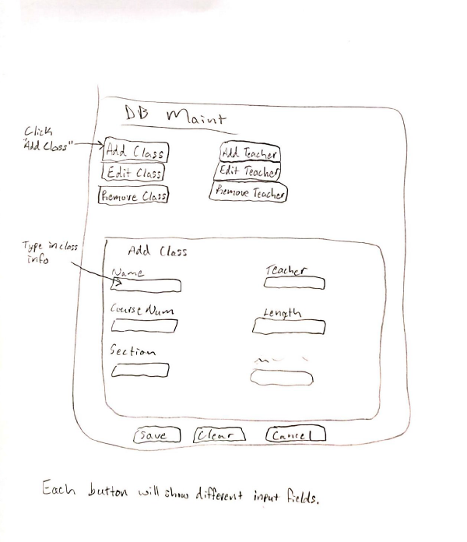

Slide 4
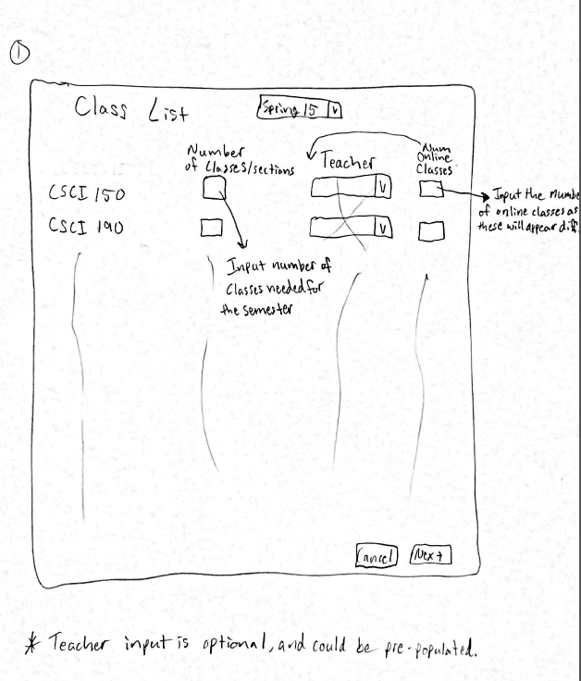
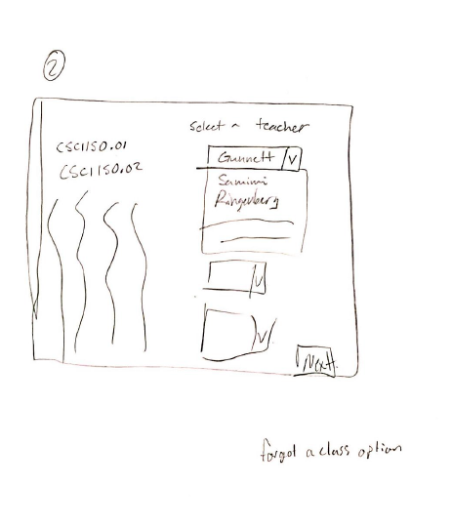

Slide 5
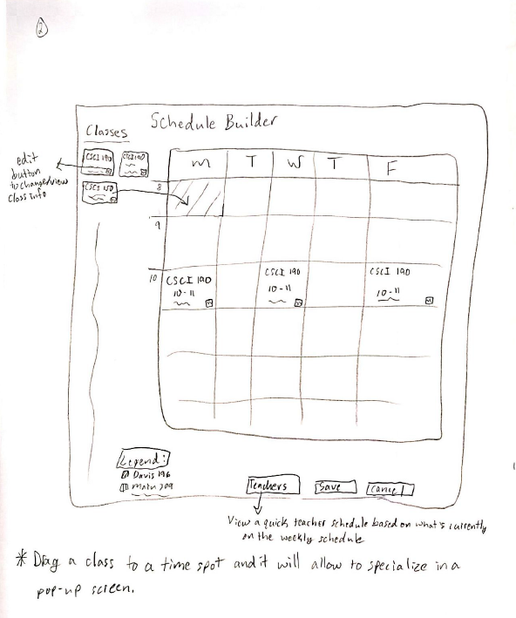
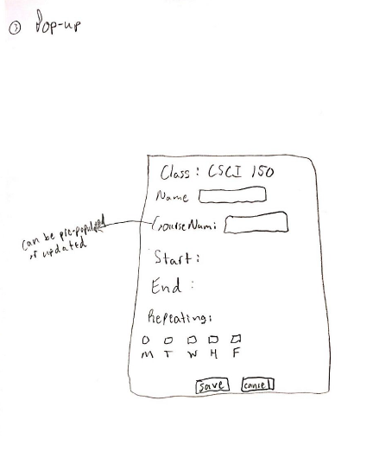

Slide 6
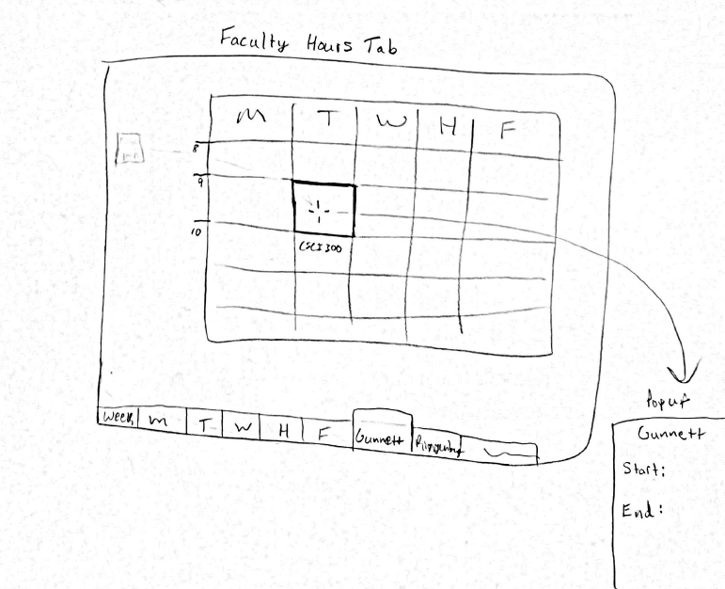

Slide 7
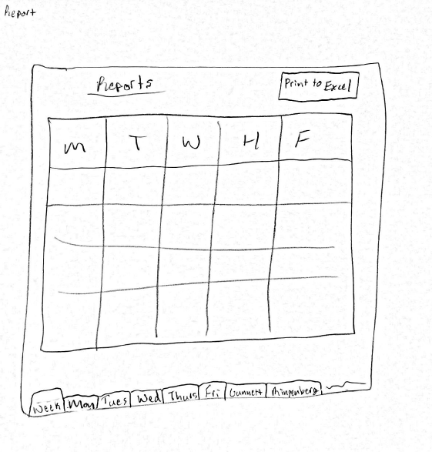
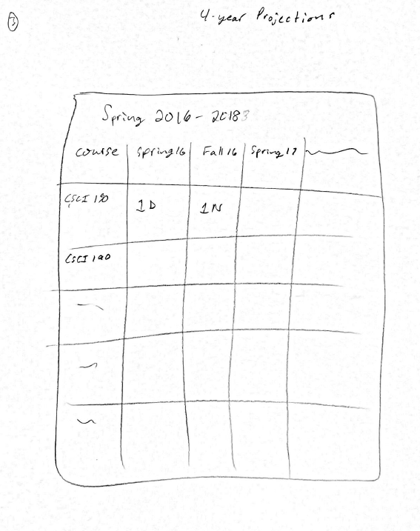

Slide 8
What We Have Yet to Accomplish
Meet again with Dr. Geise
Update priority and estimated hours for user stories
2nd draft of prototypes and use cases

